Slide 1
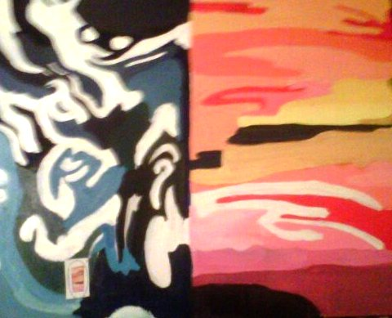
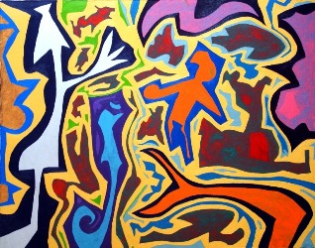
Crystal
Acrylic
30.5cm x 45.7 cm
September 2011
Keith Garrow
Not Drowning

Slide 2
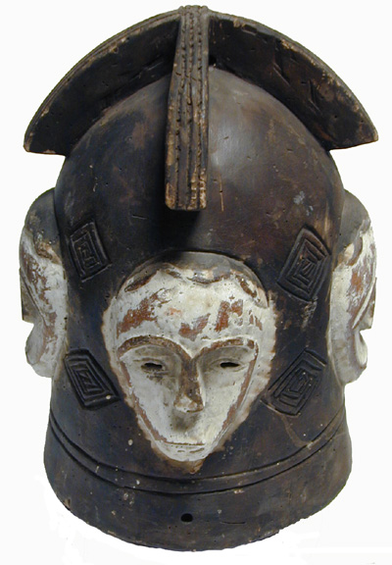
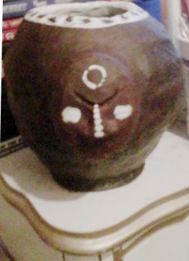
Sacred Vessel
Acrylic on Clay
December 2011
Yoruba Tribe Pottery
Untitled

Slide 3
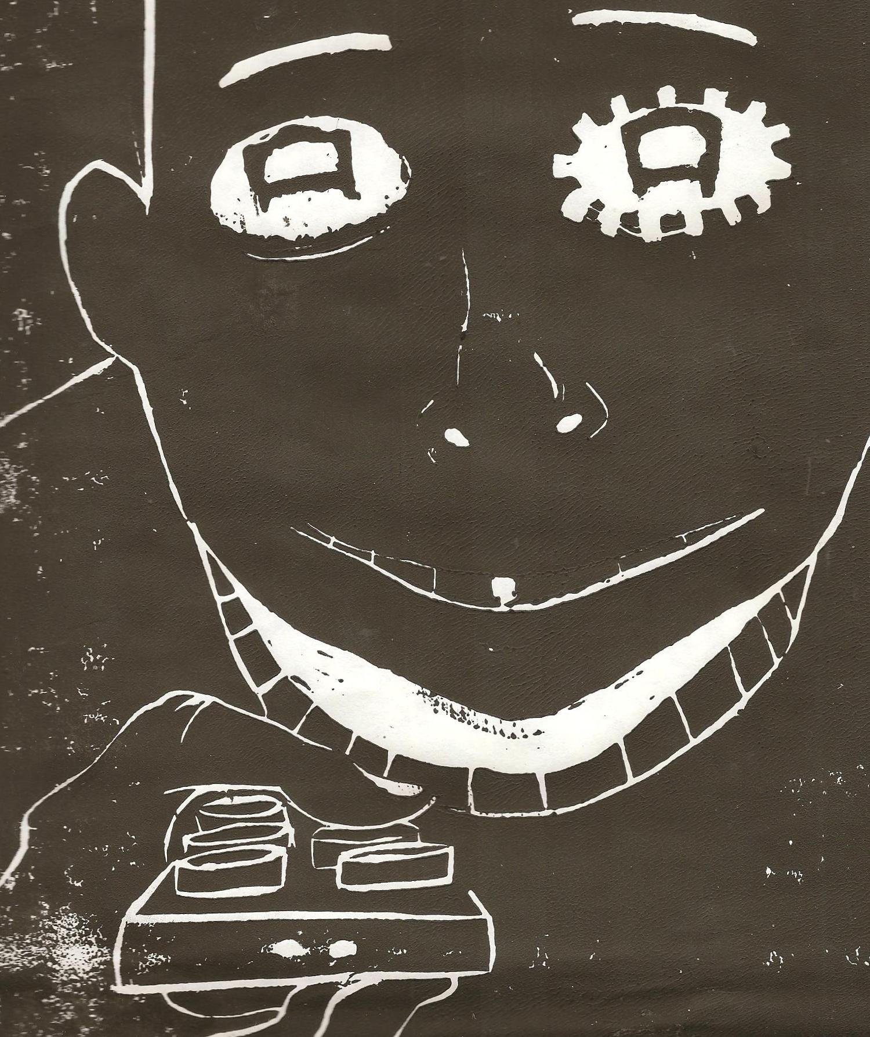
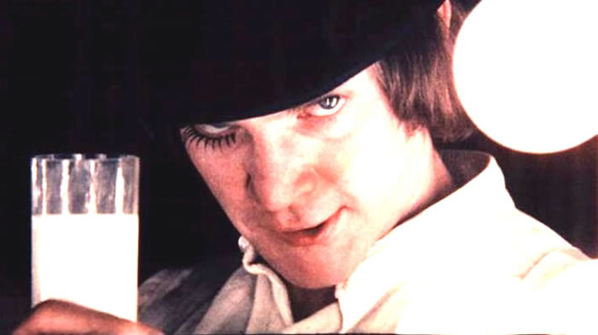
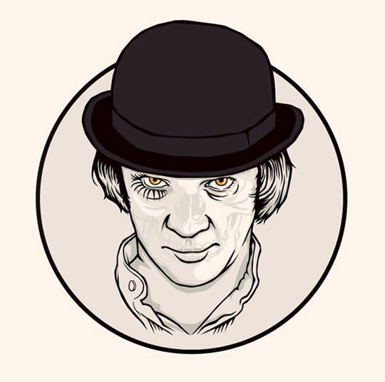
Block Print
Ink on paper
21.6 cm x 30.5 cm
February 2012
Anthony Burgess
A Clock Work Orange

Slide 4
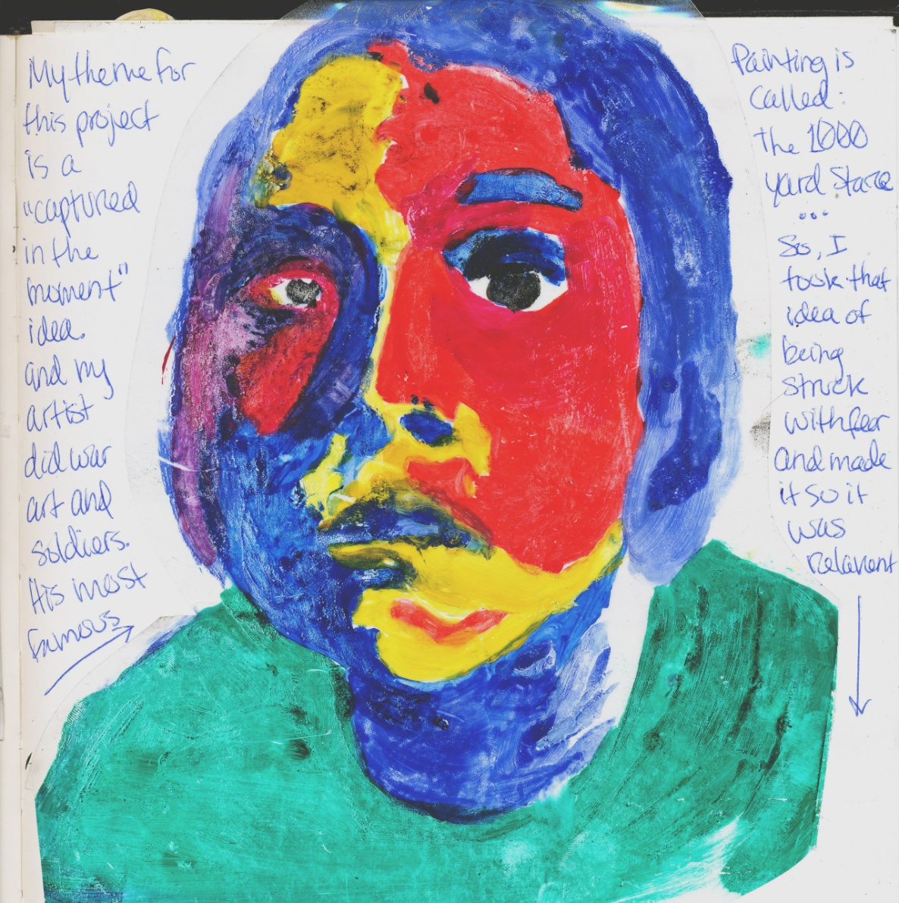
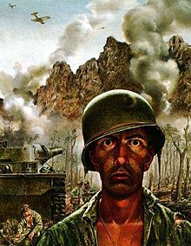
Mono Print
Acrylic and Transparency
21.6 cm x 30.5 cm
February 2012

Slide 5
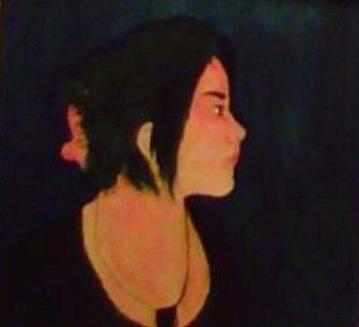
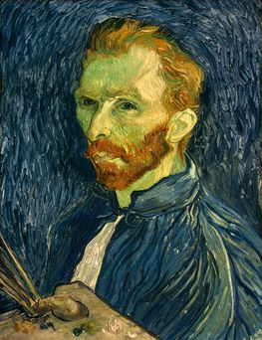
Artist
Acrylic on Canvas
91.44 cm x 91.44 cm
March 2012
Vincent Van Gogh
Self Portrait

Slide 6
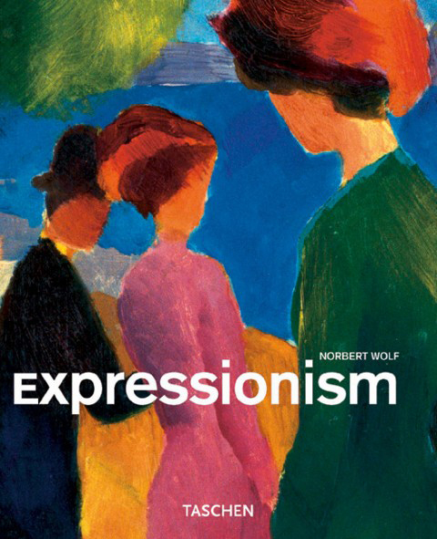
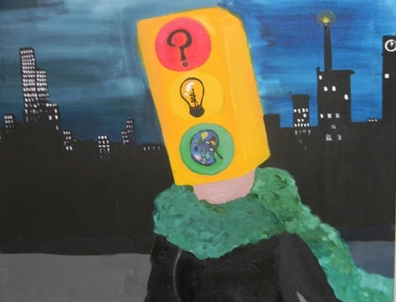
Artist in the City
Acrylic on Canvas
91.44 cm x 91.44 cm
December 2011
Art Movement: Expressionism

Slide 7
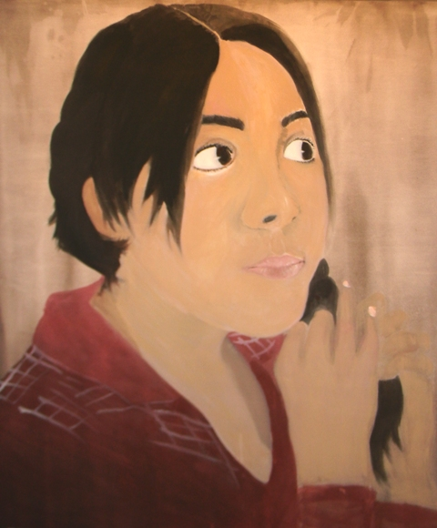
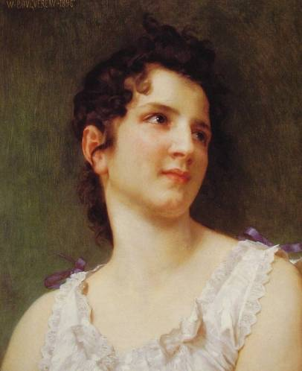
Morning Braid
Acrylic on Canvas
121.92cm x 121.92cm
February 2012
William Adolphe Bouguereau
Portrait of a young girl

Slide 8
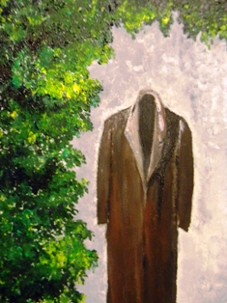
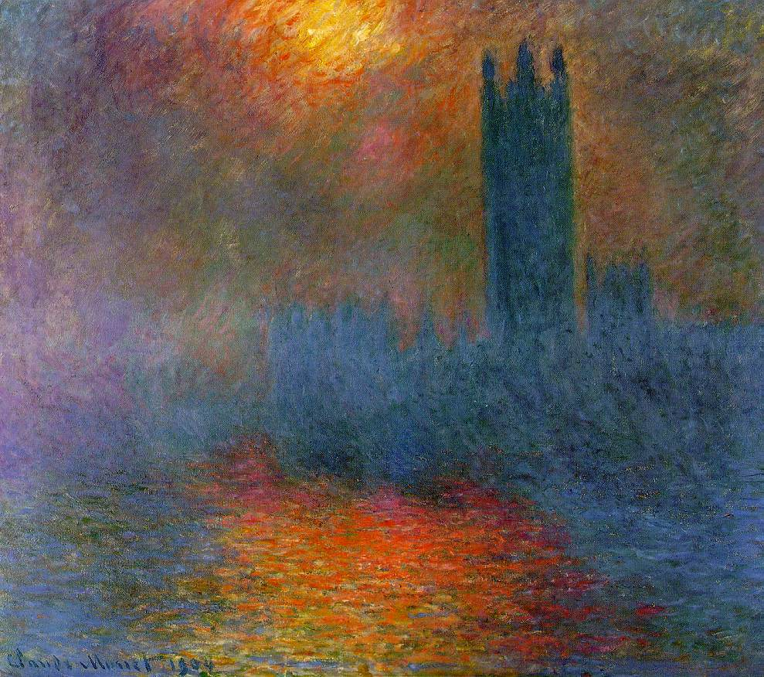
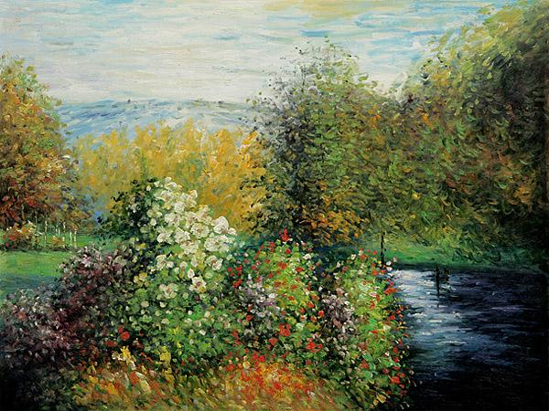
Statue in the Garden
Acrylic on Canvas
91.44 cm x 2.5 cm
April 2012
Claude Monet
London, Houses of Parliament. The Sun Shining through the Fog
Corner of the Garden at Montgeron.

Slide 9
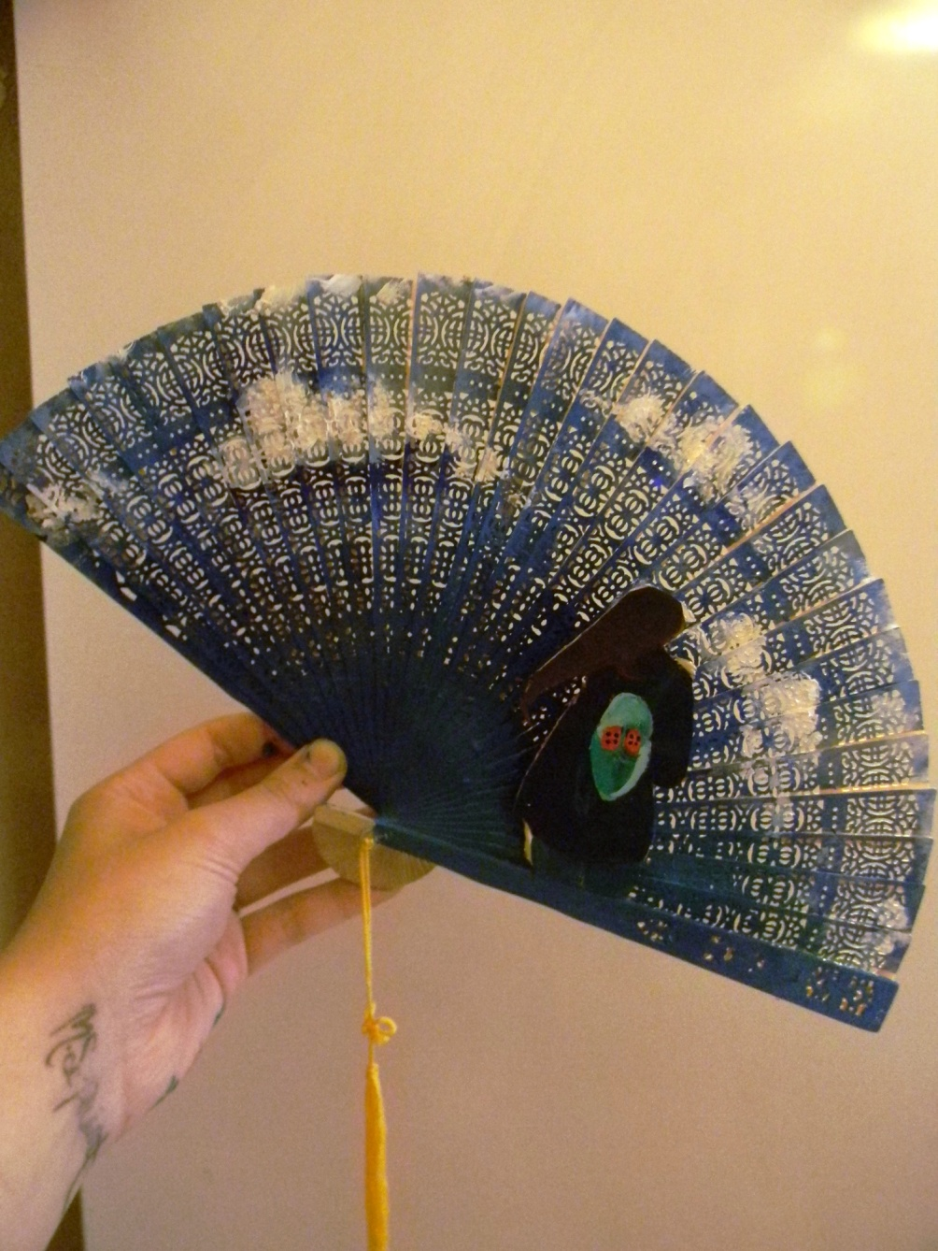
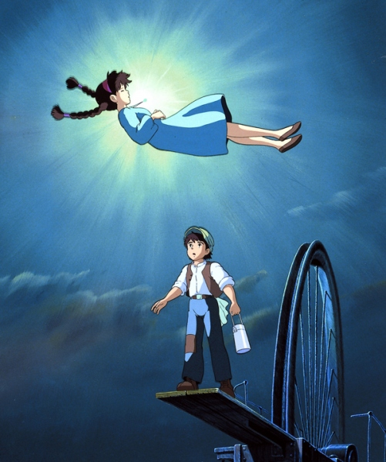
Painted Fan
Acrylic and Cardboard
17.8cm x 17.8 cm
March 2012
Castle in the Sky
hayao miyazaki- studio ghibli

